Slide 1
ORB SLAM 2
Oriented FAST Rotated BRIEF - Simultaneous Localization and Mapping
Presented by:
Tejasri Kasturi
Ruchik Jani
EECE7150 - Autonomous Field Robotics

Slide 2
INTRODUCTION
SLAM is crucial in many fields, including robotics, autonomous vehicles, drones, and augmented reality.
ORB-SLAM2 is an advanced SLAM system developed to work with different types of cameras, including monocular, stereo, and RGB-D cameras.
Key highlights of ORB-SLAM2 are:
Multi Camera Support
Real-Time Operation
Loop Closing and Map Reuse
Bundle Adjustment for High Accuracy
Relocalization

Slide 3
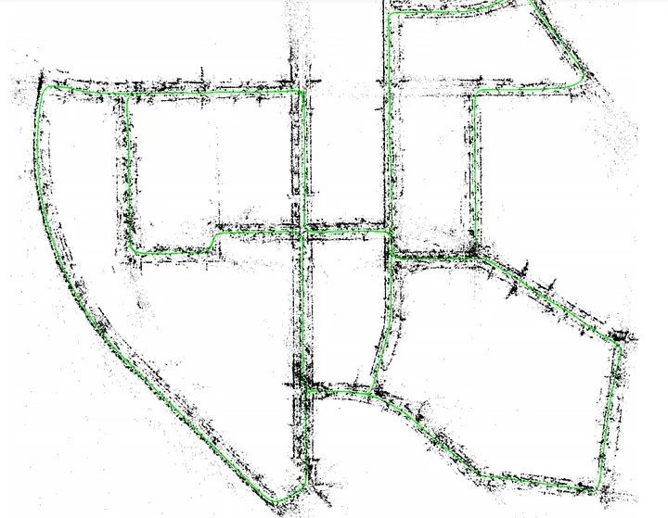
INTRODUCTION
Key Features: ORB-SLAM
Accurate Monocular SLAM solution
Map initialization and tracking using keyframe-based methods.
SLAM Systems
Monocular ORB-SLAM: ORB-SLAM2 extends the original monocular ORB-SLAM by supporting stereo and RGB-D cameras, improving both accuracy and robustness in different scenarios.
Stereo Systems: ORB-SLAM2 shows better accuracy due to its use of BA & loop closing.
RGB-D Systems: It focuses on optimizing the camera trajectory and map points, leading to more precise localization, rather than depth fusion or photometric error minimization
Key Features: ORB-SLAM 2
Enhanced support for Monocular, Stereo and RGB-D cameras
Improved tracking and mapping accuracy and optimization.
Loop closing for global consistency.

Slide 4
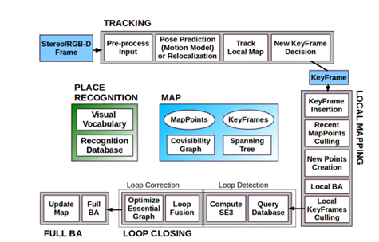
SYSTEM ARCHITECTURE
ORB-SLAM2 operates using a multi-threaded architecture to achieve real-time performance and accuracy. The system is divided into three main parallel threads, each responsible for a specific aspect of the SLAM process.
Tracking
Local Mapping
Loop Closing

Slide 5
TRACKING
The tracking is in charge of localizing the camera with every frame and deciding when to insert a new keyframe.
ORB Feature Extraction: tracking thread starts by extracting ORB features.
Feature Matching and Pose Estimation: The system matches the ORB features from the current frame to those in the local map
Relocalization: re-establishing its position if the system loses track of the camera
Keyframe Decision: A keyframe is created if significant camera motion or a lack of tracked map points.

Slide 6
Local Mapping
The local mapping thread manages and updates the local map around the current camera position.
Keyframe Insertion: The local mapping thread inserts this new keyframe into the map and updates the local covisibility graph.
Map Point Culling:The local mapping thread regularly checks map points in the local map to remove redundant or unreliable points.
Map Point Creation: The system attempts to triangulate new 3D points from pairs of keyframes. These new points are added to the local map, helping to expand the 3D model of the environment.
Local Bundle Adjustment:This optimizes the poses of the keyframes and the 3D map points within a local window around the current camera position.
Keyframe Culling:The system also removes redundant keyframes.

Slide 7
Loop Closing
The loop closing thread is responsible for detecting and correcting loop closures, which occur when the system revisits a previously mapped area, reducing the drift in the map by correcting accumulated errors in the camera trajectory and map points.
Loop Detection: The loop closing thread uses place recognition to detect when the system revisits a previously mapped location (i.e., it recognizes places the camera has seen before).
Loop correction:
Once a potential loop closure is detected, the system performs geometric validation to ensure that the match is correct.
After detecting and validating a loop, the loop closing performs pose-graph optimization.

Slide 8
FULL BUNDLE ADJUSTMENT
Runs in a separate thread, Performed after a loop closure to optimize all the camera poses and map points.
Ensures that the entire map is globally consistent, particularly after large corrections introduced by loop closures.
The system formulatesthe reprojection error as an optimization problem and adjusts the camera poses and map points to minimize this error, using the Levenberg-Marquardt algorithm.
Improves both the accuracy of the estimated camera trajectory and the 3D map points, reducing drift and errors that accumulate over time.
Map Merging: any new keyframes or points added during the optimization are merged back into the main map, ensuring that the map remains consistent.

Slide 9

Monocular, Stereo Keypoints, and System Bootstrapping
Close keypoints: If a stereo keypoint’s depth is less than 40 times the stereo/RGB-D baseline (as suggested in previous research), it is considered “close.” These keypoints can be accurately triangulated from a single frame, meaning they provide reliable scale, rotation, and translation information.
Far keypoints: If the depth exceeds this threshold, the keypoint is classified as “far.” Far points provide accurate rotation information but less reliable scale and translation. They can be triangulated over multiple frames for improved accuracy.
Stereo and RGB-D cameras allow instant map initialization by creating depth from the first frame, eliminating the need for complex structure from motion in monocular systems. This simplifies the bootstrapping process and accelerates system startup.

Slide 10

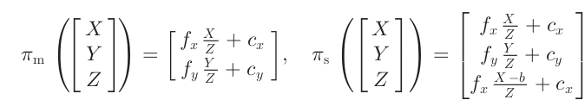
Bundle Adjustment with Monocular and Stereo Constraints
Motion-Only BA:

Slide 11


Bundle Adjustment with Monocular and Stereo Constraints
Local BA

Slide 12
Keyframe Insertion and Localization
In challenging environments with distant scenes, ORB-SLAM2 inserts a new keyframe if tracked close points drop below a threshold, ensuring accurate translation estimation by maintaining sufficient close stereo points.
ORB-SLAM2's localization mode deactivates mapping and loop closing for lightweight, long-term localization, relying on visual odometry and map point matches to track the camera in well-mapped environments while minimizing drift.

Slide 13
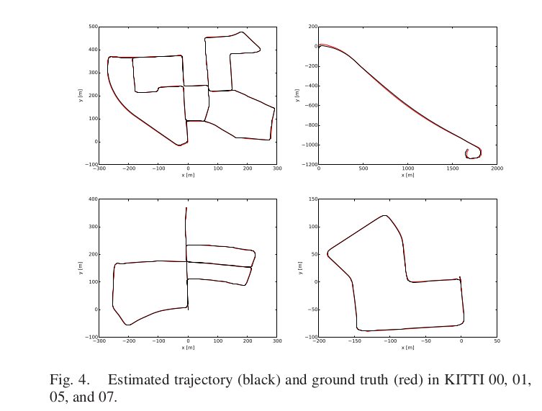
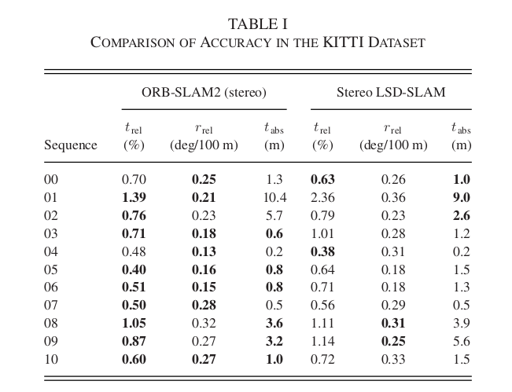
Evaluation: KITTI Dataset

Slide 14
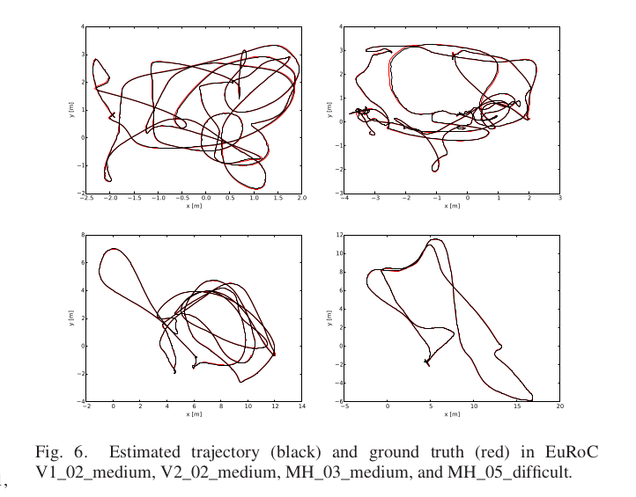
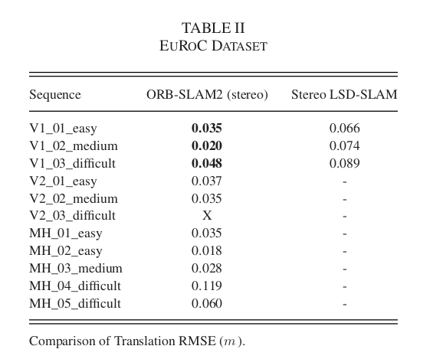
Evaluation: EUROC Dataset

Slide 15
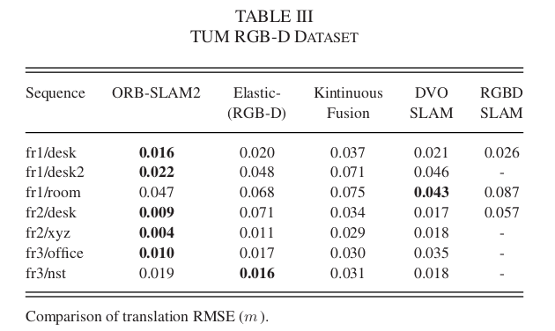
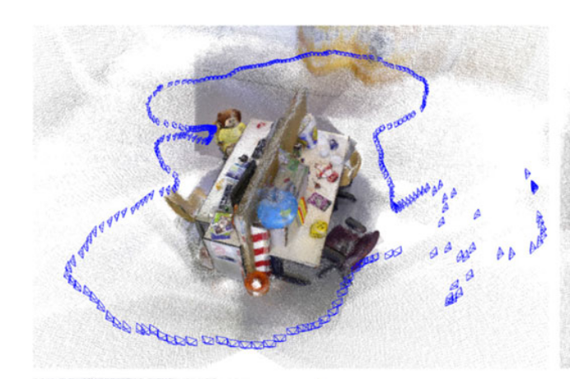
Evaluation: TUM RGB-D Dataset

Slide 16
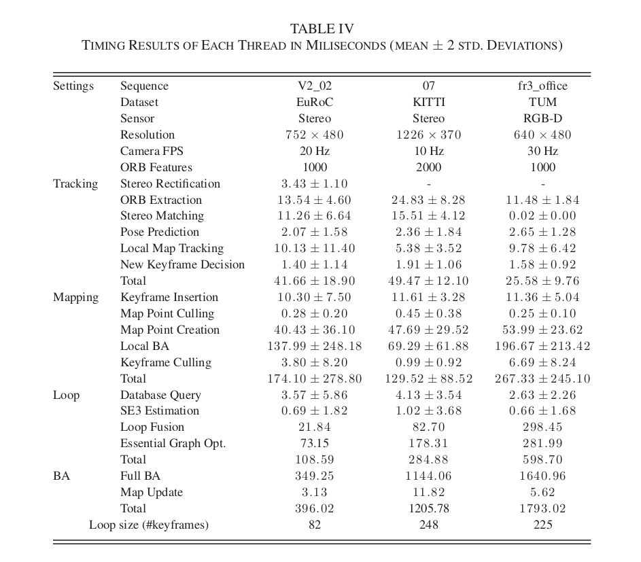
Evaluation: Timing Results

Slide 17
Conclusion
Versatility: Works with monocular, stereo, and RGB-D cameras, making it adaptable to a wide range of devices and scenarios.
Real-Time Performance: It efficiently processes sensor data in real-time on standard CPUs without needing a GPU, making it lightweight and accessible for many applications.
Zero-Drift Localization - It achieves this in already mapped areas, especially in stereo SLAM, which sets it apart from other visual odometry methods.
Bundle Adjustment: It uses this for higher accuracy in RGB-D localization, outperforming direct methods and ICP (Iterative Closest Point).
Support for Non-Overlapping Cameras: More work is required on adding support for multi-camera setups with nonoverlapping fields of view.
Motion Blur Robustness: Enhancing performance in scenarios with significant motion blur is also a possible future endeavor.

Slide 18
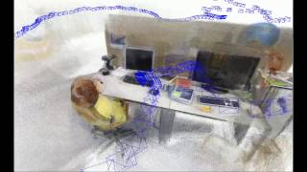
Video Demonstration by the Paper’s Authors

Slide 19
References
https://medium.com/@sallyrobotics.blog/a-review-on-orb-slam-2-paper-3554d4fcaa7c
https://cseweb.ucsd.edu/~mkchandraker/classes/CSE291/2017/Presentations/07_Real_Time_SFM_Sudhanshu.pdf
Video Demonstration by the Paper’s Authors (Link) - https://www.youtube.com/watch?v=ufvPS5wJAx0&t=3s
Github repository link for the paper - https://github.com/raulmur/ORB_SLAM2/tree/master

